Slide 1
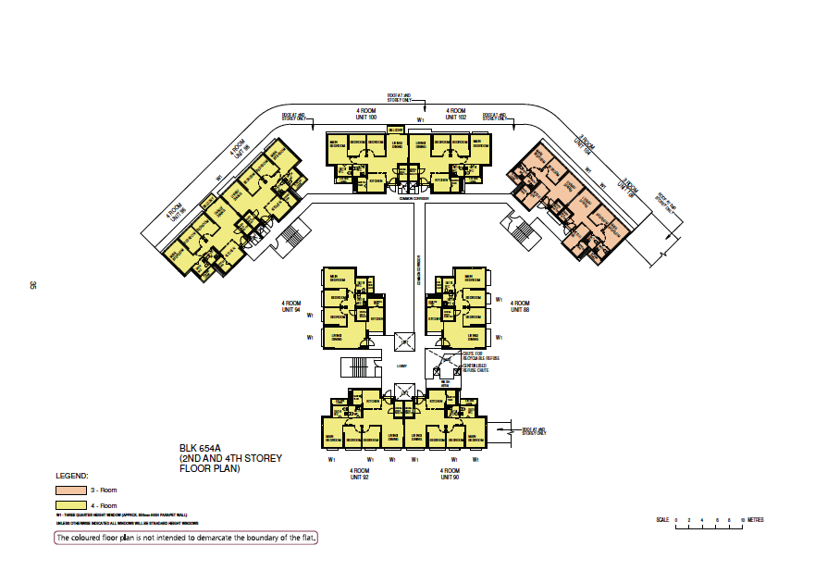

Slide 2
Blk 654A
1st Storey
Unit 94
Unit 88

Slide 3
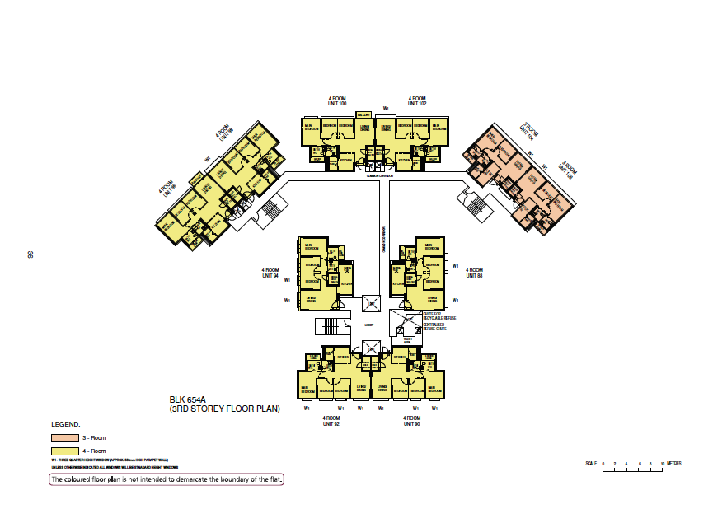

Slide 4
Blk 654A
2^{nd to} 8th Storey
Unit 100
Unit 102
Unit 98
Unit 104
Unit 96
Unit 106
Unit 94
Unit 88
Unit 92
Unit 90

Slide 5
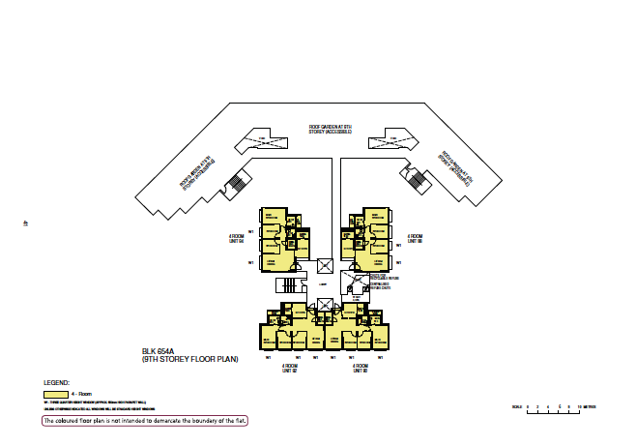

Slide 6
Blk 654A
9th Storey
(Roof Garden)
Unit 94
Unit 88
Unit 92
Unit 90

Slide 7
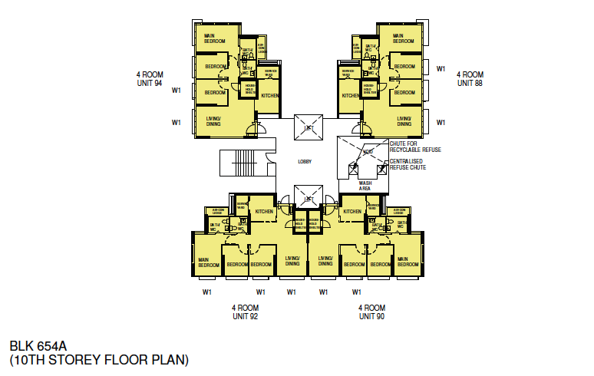

Slide 8
Blk 654A
10^{th to} 18th Storey
Unit 94
Unit 88
Unit 92
Unit 90

